Slide 1
RL-Course 2024/25: Final Project
Improvement Through Reinforcement: Nils Großepieper (TD3), Mátyás Pólya (SAC)
Notes:
Hello everyone, today we will present our project on reinforcement learning in laser hockey

Slide 2

The laser hockey environment
Game of two players
Agent receives 18 observations: states of the two player and the puck
Agent has an action space that contains four continuous actions: moving (x and y direction), turning and shooting
One game ends after 250 episodes or when one player scores a goal
Object of this project is to train an agent that performs well in this environment
Notes:
The laser hockey environment is a 2-player based simulation.
The environment has 18 observations, including player states and puck position
With the actions we can move and turn the agent, and shoot the puck

Slide 3
TD3 - Overview
TD3 is an off-policy algorithm that was created to overcome overestimation bias and stabilize policy learning
TD3 achieves this by using these three techniques:
1.) Twin Q-learning mitigates overestimation bias of Q-values
2.) Target policy smoothing reduces overfitting
3.) Delayed policy updates lead to more stable training updates
TD3 includes two Q-networks and one policy-network
Notes:
The soft actor-critic was developed to improve sample efficiency and stability over traditional actor-critic methods
It is an Off-policy algorithm that balances exploration and exploitation using entropy maximization.
The objective of the policy is the following equation, where
The second term encourages exploration
The implementation includes 2 Q-networks, 2 target Q-networks and a policy network

Slide 4
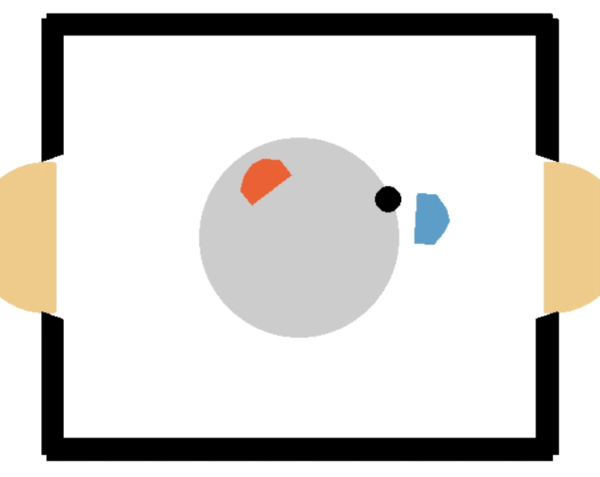
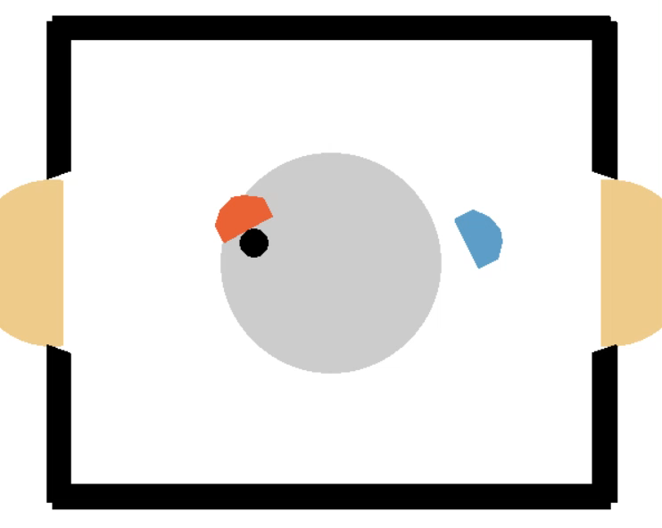
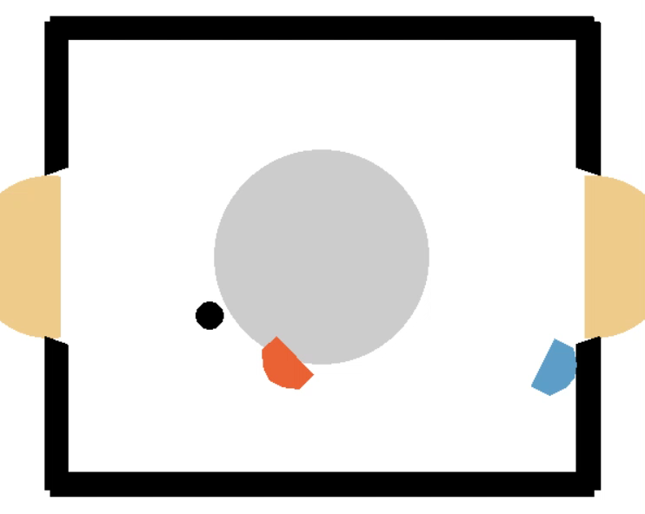
TD3 - Gameplay
Against the weak opponent
Against the strong opponent
Against itself
Notes:
Here we can see some episodes of the resulting agent, trained against the weak and the strong opponent and itself

Slide 5
TD3 - Experiments
Notes:
Now we will look at some experiments done on SAC

Slide 6
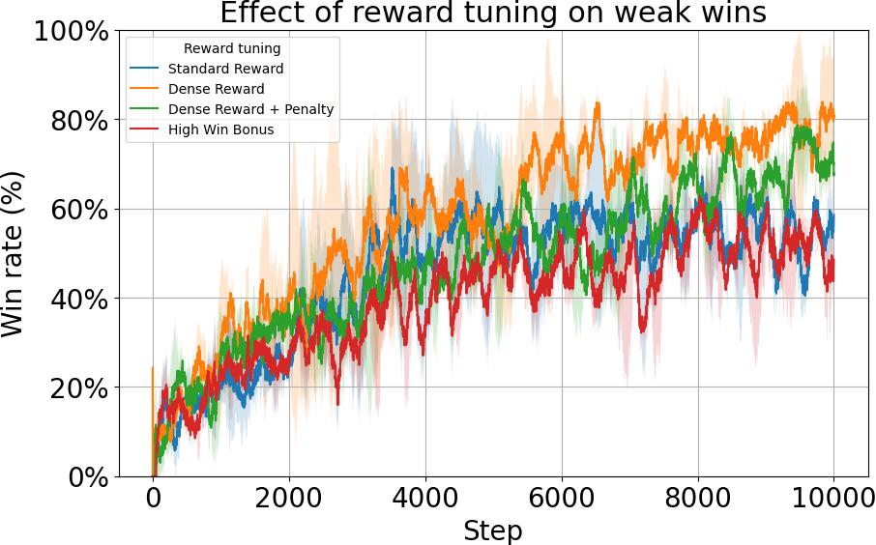
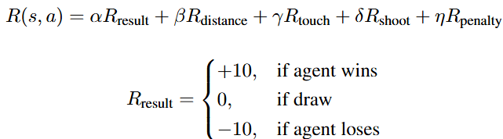
TD3 – Experiments: Reward Function
Standard reward does not improve the agents' performance after ~5000 episodes
Denser reward improves the agent's outcome
High Win Bonus might introduce reward scale disparity
Notes:
First, we looked at the impact of the entropy parameter \alpha, a key hyperparameter in SAC.
We compared three approaches: keeping α constant, exponentially annealing it, and adaptively tuning it.
The plot shows that adaptive tuning performed the best, while keeping alpha constant led to poor performance. This makes sense because a constant α prevents the agent from properly transitioning from the exploration phase to the exploitation phase

Slide 7
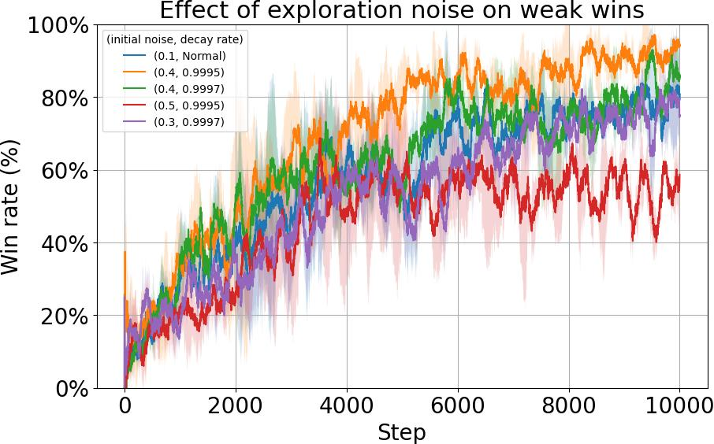
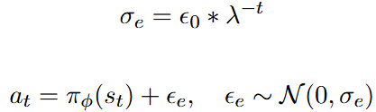
TD3 – Experiments: Exploration Noise
Exponential decay improves the agent's performance
High initial exploration noise decreases the agent's performance
Exploration noise:
Notes:
First, we looked at the impact of the entropy parameter \alpha, a key hyperparameter in SAC.
We compared three approaches: keeping α constant, exponentially annealing it, and adaptively tuning it.
The plot shows that adaptive tuning performed the best, while keeping alpha constant led to poor performance. This makes sense because a constant α prevents the agent from properly transitioning from the exploration phase to the exploitation phase

Slide 8
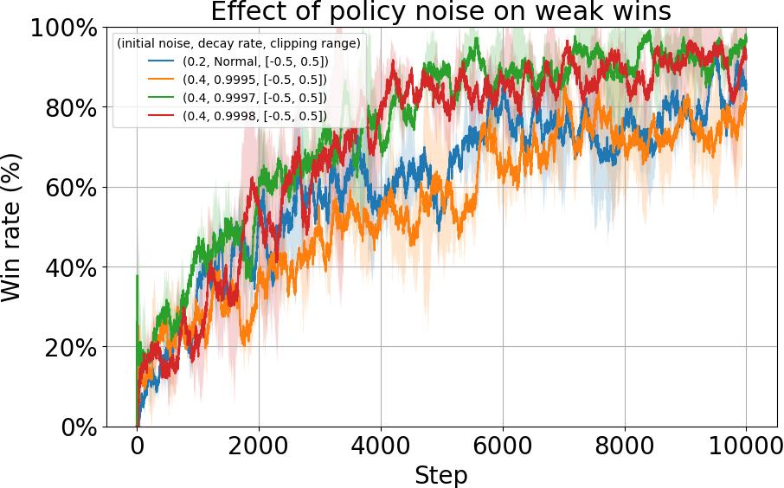
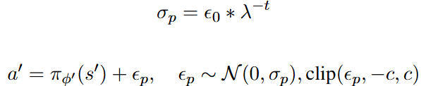
TD3 – Experiments: Policy Noise
Exponential decay improves the agent's performance
A decay rate that is too small or too high might reduce performance
Policy noise:
Notes:
First, we looked at the impact of the entropy parameter \alpha, a key hyperparameter in SAC.
We compared three approaches: keeping α constant, exponentially annealing it, and adaptively tuning it.
The plot shows that adaptive tuning performed the best, while keeping alpha constant led to poor performance. This makes sense because a constant α prevents the agent from properly transitioning from the exploration phase to the exploitation phase

Slide 9
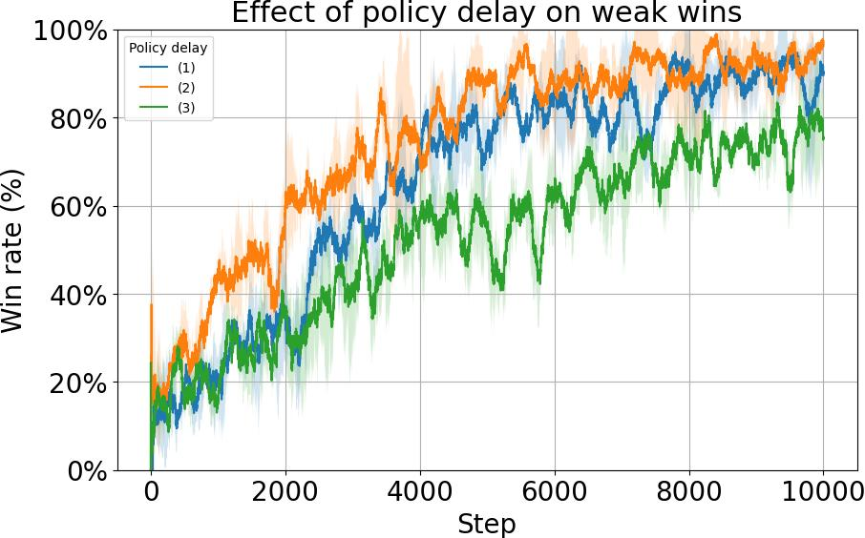
TD3 – Experiments: Policy Delay
A policy decay that is too high or too low might decrease the performance
A smaller policy delay performs better than a bigger policy delay
Notes:
First, we looked at the impact of the entropy parameter \alpha, a key hyperparameter in SAC.
We compared three approaches: keeping α constant, exponentially annealing it, and adaptively tuning it.
The plot shows that adaptive tuning performed the best, while keeping alpha constant led to poor performance. This makes sense because a constant α prevents the agent from properly transitioning from the exploration phase to the exploitation phase

Slide 10
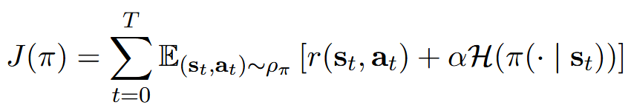
Soft Actor-Critic - Overview
Developed to improve sample efficiency and stability over traditional actor-critic methods
Off-policy algorithm that balances exploration and exploitation using entropy maximization.
The second term encourages exploration
It includes 2 Q-networks, 2 target Q-networks and a policy network
Notes:
Now I will talk about our second model, the soft actor critic.
The soft actor-critic was developed to improve sample efficiency and stability over traditional actor-critic methods
It is an Off-policy algorithm that balances exploration and exploitation using entropy maximization.
The objective of the policy is the following equation, where
The second term encourages exploration
The implementation includes 2 Q-networks, 2 target Q-networks and a policy network

Slide 11
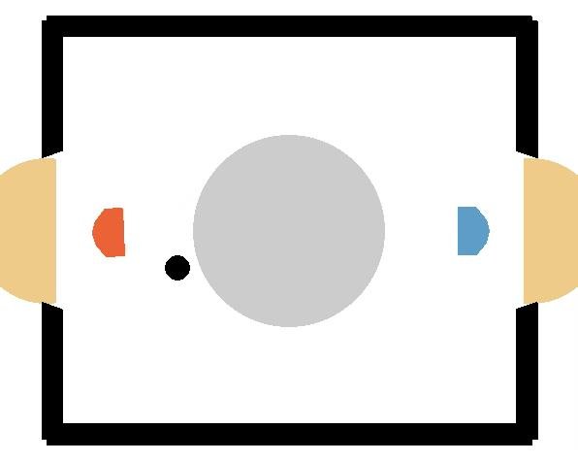
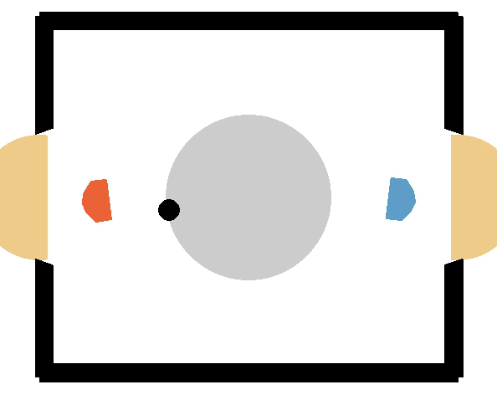
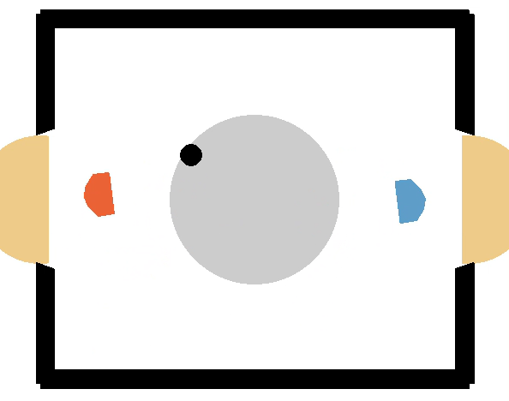
Soft Actor-Critic - Gameplay
Against the weak opponent
Against the strong opponent
Against itself
Notes:
Here we can see some episodes of the resulting agent, trained against the weak and the strong opponent and itself

Slide 12
Soft Actor-Critic - Experiments
Notes:
Now we will look at some experiments done on SAC

Slide 13
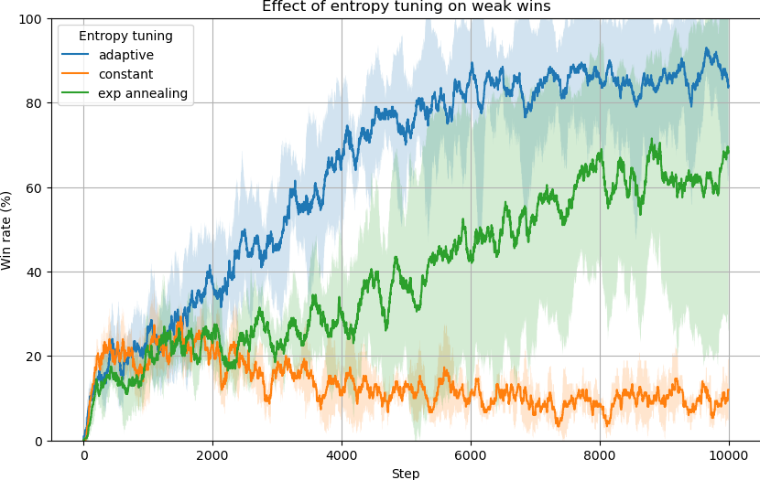

Soft Actor-Critic Experiments: α
The entropy parameter is very important
3 different ways:
Adaptive tuning
Exponential annealing
Constant
Adaptive tuning:
Notes:
First, we looked at the impact of the entropy parameter \alpha, a key hyperparameter in SAC.
We compared three approaches: keeping α constant, exponentially annealing it, and adaptively tuning it.
The plot shows that adaptive tuning performed the best, while keeping alpha constant led to poor performance. This makes sense because a constant α prevents the agent from properly transitioning from the exploration phase to the exploitation phase

Slide 14
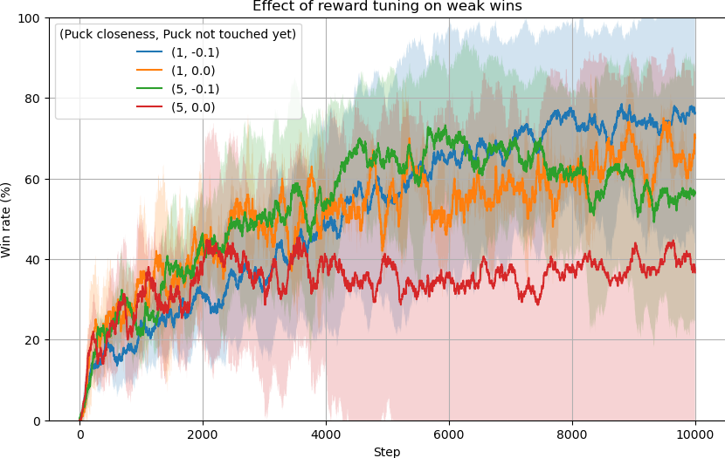
Soft Actor-Critic Experiments: r
Different reward formulations:
Multiplying the puck closeness reward
Penalizing not touching the puck
Notes:
Next, we examined different reward formulations.
Originally, the agent got a big reward based on the outcome of the game, with additional penalties, if the puck was on its side of the playing area.
We tested multiplying this puck closeness reward with different values, and also adding penalty for not touching the puck in the episode.
The results show that adding the ‘puck not touched’ penalty improved performance, especially when the puck closeness multiplier was high.
Furthermore, increasing the ‘puck closeness reward’ worsened the performance.

Slide 15
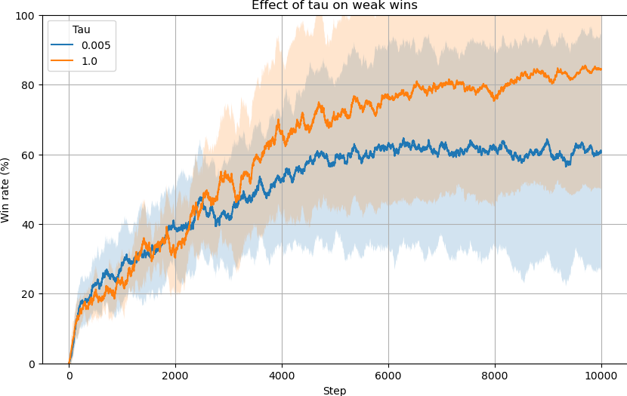
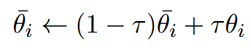
Soft Actor-Critic Experiments: τ
Comparison between:
Soft update
Hard update
Notes:
Finally, we analyzed the effect of soft and hard target updates.
The plot shows that hard target updates significantly improved performance. This phenomenon was also mentioned in the original SAC paper, some environments benefit from hard target updates.

Slide 16
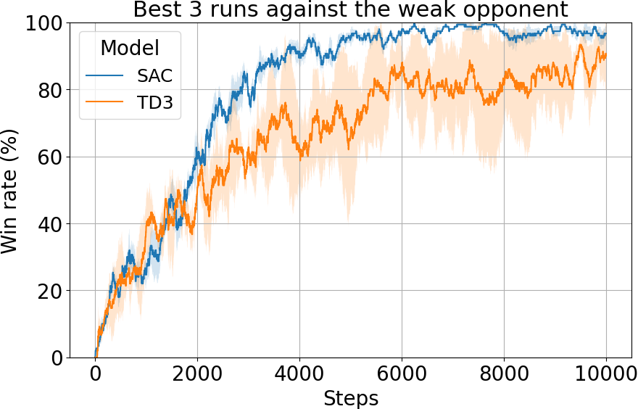
Overview
SAC outperform TD3
SAC exhibits lower variance
More experiments were conducted on SAC, possibly inflating results.
Notes:
In the end We analyzed the best-performing models based on their win rate against a weak opponent. The SAC models performed better overall and had lower variance, which aligns with previous research. However, it's important to note that SAC had more training runs, which might have influenced the results
While SAC has advantages in exploration and robustness, TD3 remains competitive, especially in deterministic settings. The final performance of both models are similar, as each brings different strengths to the table.

